Slide 1
Presentation on
Swayampurna Goa
By
Electricity Department.

Slide 2
Online Application for New Connections & other Services.
Other Services:
Change of Load
Change of Name
Change of Category.
Shifting of meters
Visit Electricity Department Website: https://www.goaelectricity.gov.in

Slide 3
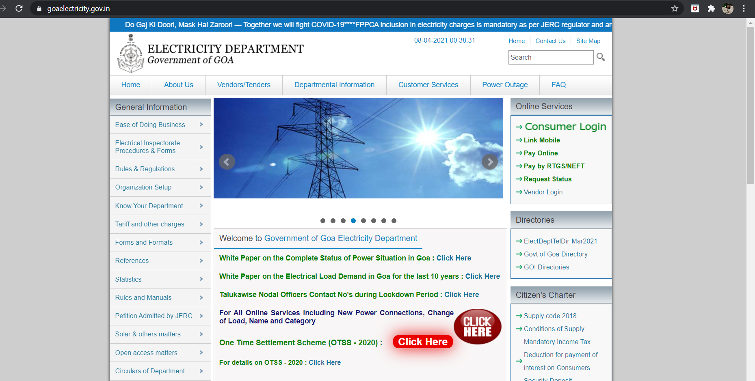
Screenshot of Department website

Slide 4
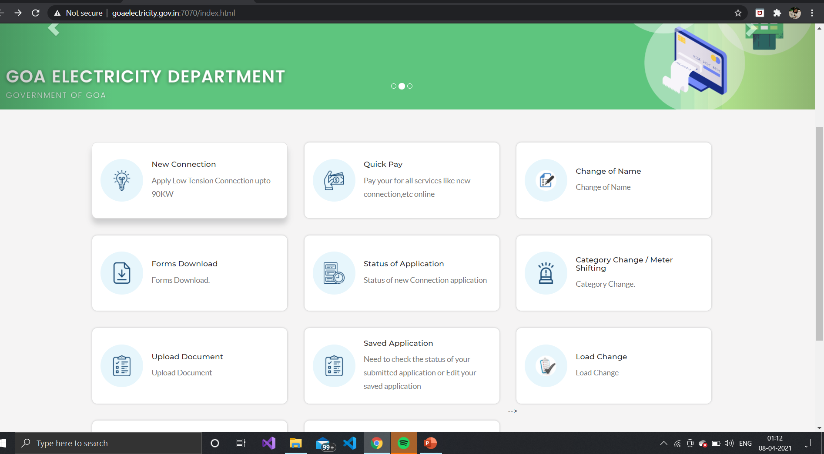
Screenshot of Webpage for All Online services

Slide 5
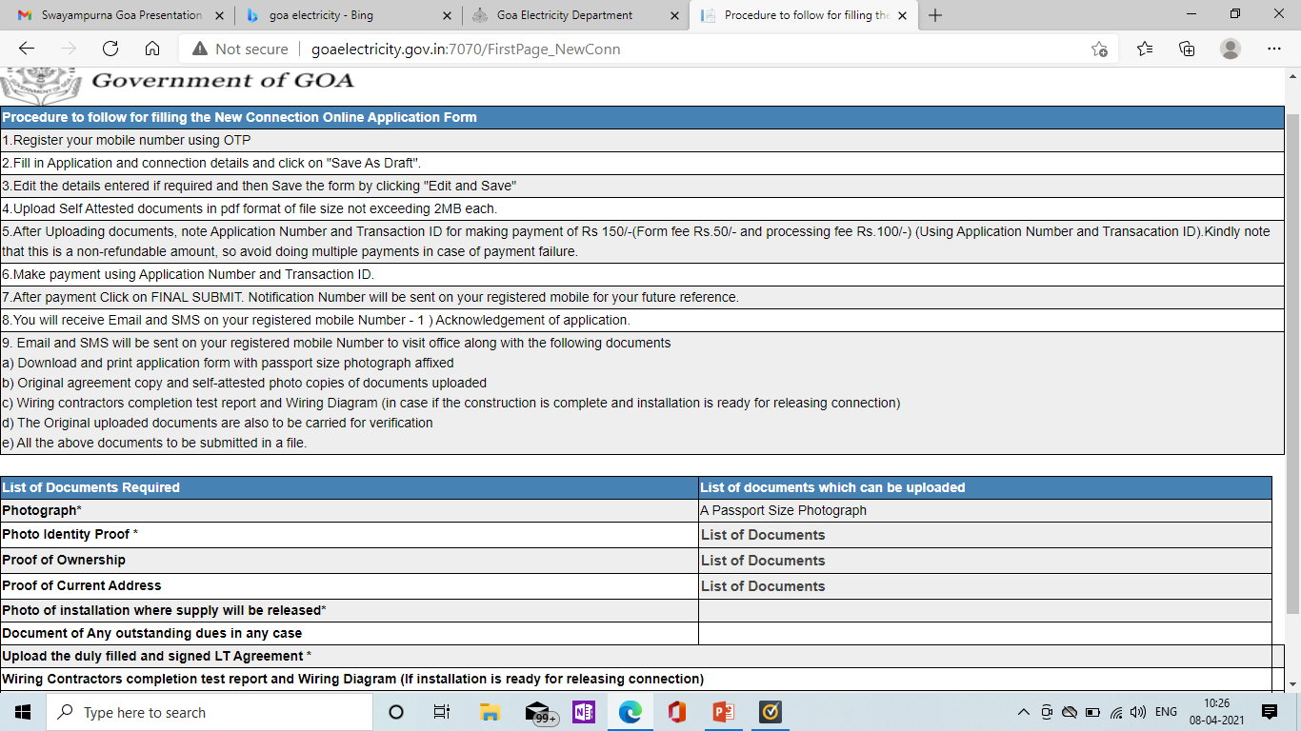
Screenshot for New Power Connections

Slide 6
Department Contact Persons for Swayampurna Goa
Taluka : Tiswadi
Contact Person: Shri Arun Patil
Designation: Executive Engineer
Mobile No: 8380015001
e-mail ID: ee1-elec.goa@nic.in
Taluka : Bardez
Contact Person: Shri Pradip Narvekar
Designation: Executive Engineer
Mobile No: 8380015006
e-mail ID: ee6-elec.goa@nic.in

Slide 7
Taluka : Pernem
Contact Person: Shri Mallappa H.
Designation: Executive Engineer
Mobile No: 8380015017
e-mail ID: eediv17@gmail.com
Taluka : Bicholim & Sattari
Contact Person: Shri Sebastiao Fernandes
Designation: Executive Engineer
Mobile No: 8380015005
e-mail ID: ee5-elec.goa@nic.in

Slide 8
Taluka : Ponda & Dharbandora
Contact Person: Shri Vallabh Samant
Designation: Executive Engineer
Mobile No: 8380015010
e-mail ID: eeten@rediffmail.com
Taluka : Mormugao
Contact Person: Shri Paulito Viegas
Designation: Executive Engineer
Mobile No: 8380015011
e-mail ID: exeengelect11@rediffmail.com

Slide 9
Taluka : Salcette
Contact Person: Shri Alvito Fernandes
Designation: Executive Engineer
Mobile No: 8380015004
e-mail ID: eeivgoa@gmail.com
Taluka : Canacona
Contact Person: Shri Rajendra Sawant
Designation: Executive Engineer
Mobile No: 8380015016
e-mail ID: ee16goa@rediffmail.com

Slide 10
Taluka : Sanguem & Quepem
Contact Person: Shri Vinayak Mhalshekar
Designation: Executive Engineer
Mobile No: 8380015007
e-mail ID: eediv7@yahoo.co.in

Slide 11
THANK YOU

